Slide 1
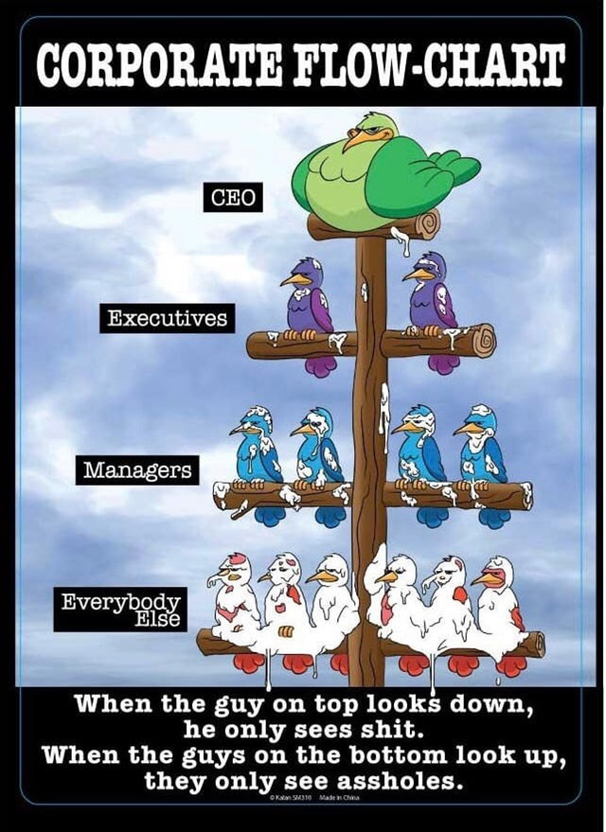
Health and Work
Lecture 1- Context

Slide 2

Welcome

Slide 3
Learning Outcomes
1. To understand the political and social contexts of health and work in the UK;
2. To critically evaluate theory, best practice and the underpinning legislation that influences health and wellbeing at work;
3. To evaluate the positive and negative impacts of work on health and wellbeing;
4. To critically assess the contemporary issues that impact on health at work.
5. To analyse how health and wellbeing can be promoted at work.

Slide 4
Assessment
Case Study- 4000 (weighted at 100%) From a public health/health promotion perspective examine a contemporary workplace issue and critically evaluate the current or proposed strategies for managing it.

Slide 5

Why do we need work?

Slide 6
Why do we need work?
Income (Individual Economy)
Reduces isolation
Self-esteem
Identity
Security
Satisfaction
Davies, A.R., Homolova, L., Grey, C. and Bellis, M.A. (2017)
Mass Unemployment Events (MUEs) – Prevention and Response from a Public Health Perspective. Cardiff: Public Health Wales

Slide 7
Why does the government need us to work?

Slide 8
Why does the government need us to work?
Commercial Economy
To help grow the economy
Employers tend to invest when they have confidence in their ability to deliver and can anticipate a future profit
Public Economy
To avoid burden on benefits and welfare systems
To avoid burden on health systems
Social Economy
Avoid burden on voluntary sector
Avoid burden on communities
Notes:
Welfare state is being broken up and rearranged locally but is in financial difficulty

Slide 9
Health and The Economy
It’s more important though, than the ‘drain’ caused by sick people
If people can work and contribute to the system through their taxes
Theoretically they can contribute to a more inclusive equitable economy...

Slide 10
BUT (!)
We know that individuals who have disability and poor health can experience:
Disparity and inequalities
Economic Disadvantage
And we also know that sometimes policies to resolve this can make things worse e.g.
Increased inequalities under New Labour
Universal credit
The whole system needs to work in harmony

Slide 11
What are the costs ?

Slide 12

That’s actually quite difficult to calculate!
It depends on who is calculating it, AND
What they calculate...
Absence/presenteeism
Injury
Specific disease
Disability
Worklessness
Cost to employer
Cost to inland revenue
Cost to economy
Cost to NHS
Lost tax receipts
Benefits/welfare uptake
ETC.

Slide 13
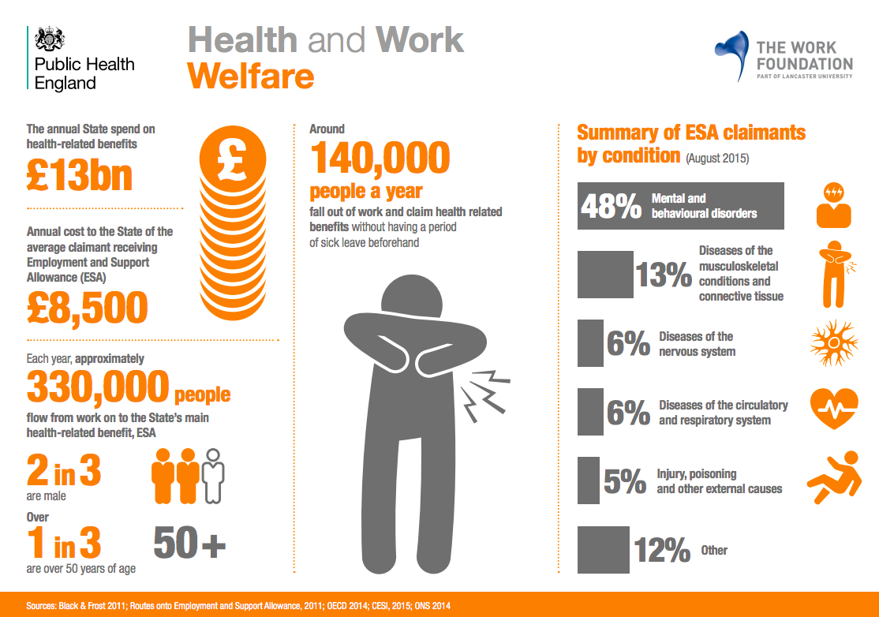
http://www.theworkfoundation.com/wp-content/uploads/2017/03/Health_and_work_infographics.pdf

Slide 14
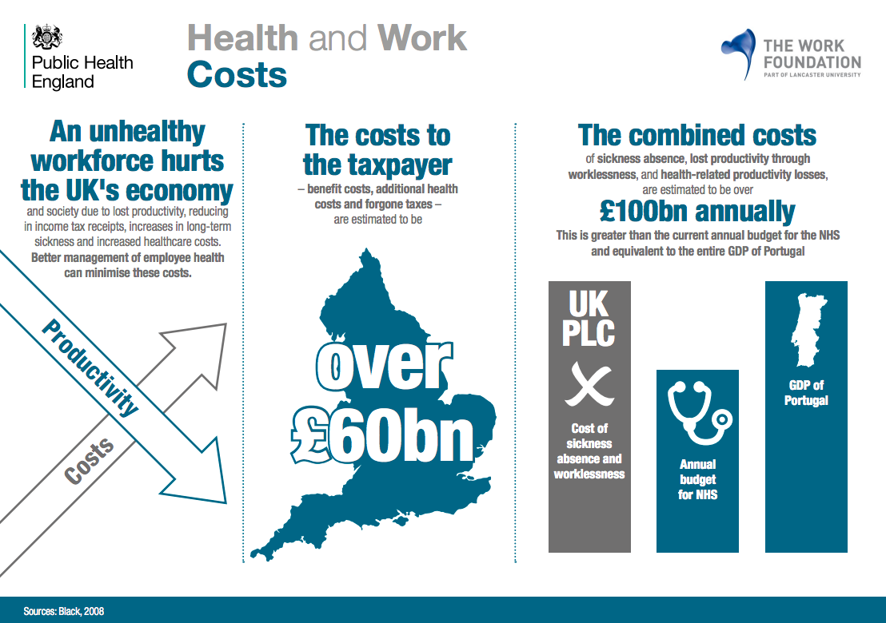
http://www.theworkfoundation.com/wp-content/uploads/2017/03/Health_and_work_infographics.pdf

Slide 15
The cost of ill health on the UK economy (Scarborough et al., 2011)
Lifestyle diseases
Cost to the NHS 2006-2007 = £18.4 billion
Poor diet-related ill health= £5.8 billion
Physical inactivity = £0.9 billion
Smoking = £3.3 billion
Alcohol = £3.3 billion
Overweight and obesity = £5.1 billion

Slide 16
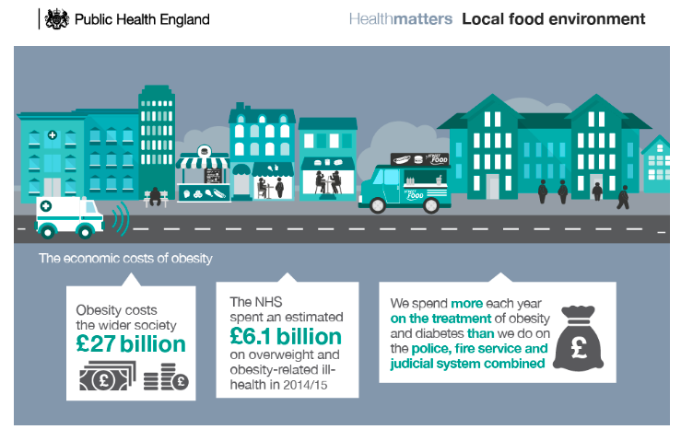
The cost of ill health on the UK economy
Obesity
https://www.gov.uk/government/publications/health-matters-obesity-and-the-food-environment/health-matters-obesity-and-the-food-environment--2

Slide 17
The cost of ill health on the UK economy (Lui et al., 2002)
Coronary Heart Disease
In 1999, the total annual cost of all coronary heart disease related burdens was £7.06 billion
£1.73 billion to the UK health care system
£2.42 billion in informal care
£2.91 billion in friction period adjusted productivity loss; 24.1% of production losses were attributable to mortality and 75.9% to morbidity.
Notes:
The friction period is the period of employees’ absence from work before the employer replaces them with other workers.

Slide 18
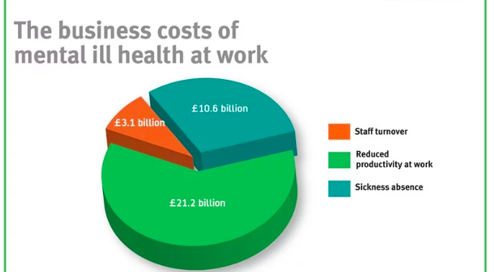
The cost of ill health on the UK economy
Mental health problems at work cost UK economy £34.9bn last year
https://www.centreformentalhealth.org.uk/mental-health-at-work-report

Slide 19
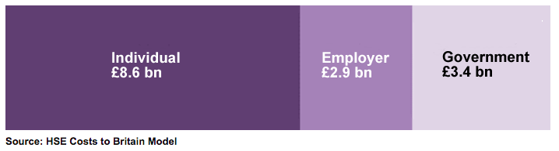
The cost of ill health on the UK economy
Workplace injury and ill health (2015/16)
“between 2014/15 and 2016/17 an average of 614,000 workers were injured in workplace accidents and a further 521,000 workers suffered a new case of ill health which they believe to be caused or made worse by their work”
http://www.hse.gov.uk/statistics/cost.htm

Slide 20
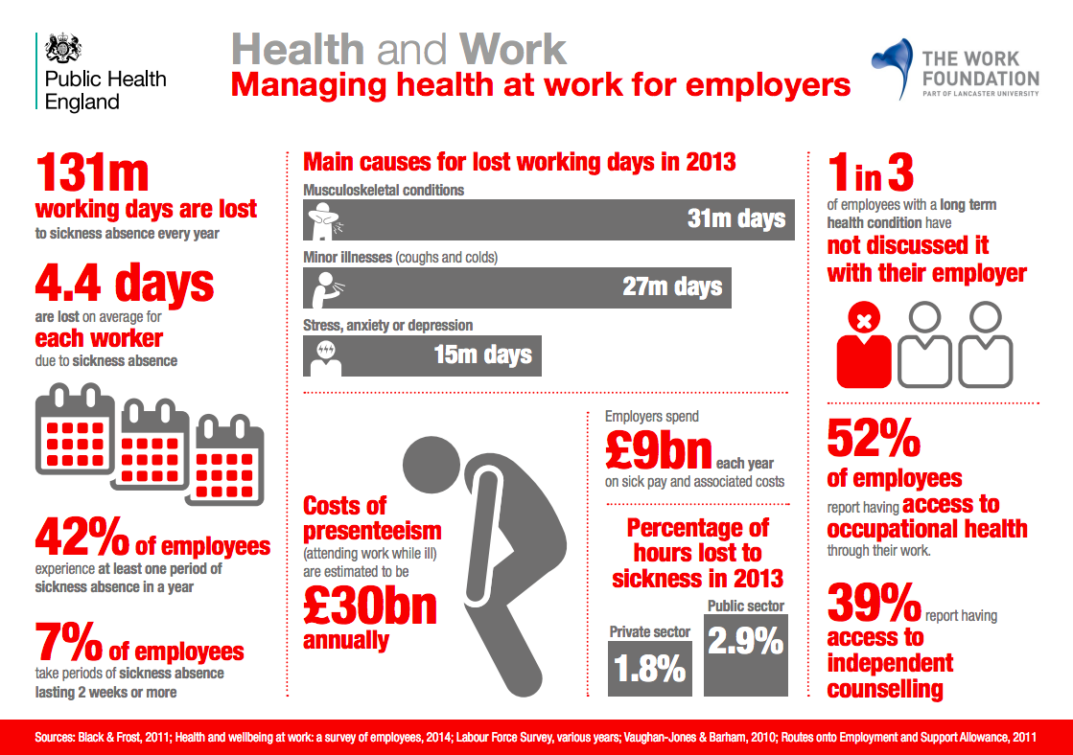
http://www.theworkfoundation.com/wp-content/uploads/2017/03/Health_and_work_infographics.pdf

Slide 21
So whose job is prevention?

Slide 22

“only around 4% of the UK health budget is spent on prevention”
“To reduce preventable ill health... the ‘causes of the causes’ must be addressed – the social, economic and environmental factors that drive our health, including housing, education and employment. These are largely outside the control of health services, and tackling them requires coordinated action across different sectors of government and society. Public health teams in England ... [may have] influence over these wider determinants of our health, but their budgets have been cut by £200m (7%) this year and further cuts of 4% a year are planned until 2020/21.”
Marshall, L. (2016) Blog: the economic case for preventing ill health Available at: https://www.health.org.uk/blog/economic-case-preventing-ill-health

Slide 23
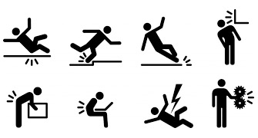
Employers
Legal obligation to protect health
Health and Safety at Work Act 1974
Management of Health and Safety at Work Regulations, 2006
Other specific regulations relating to the nature of the hazard to health.

Slide 24

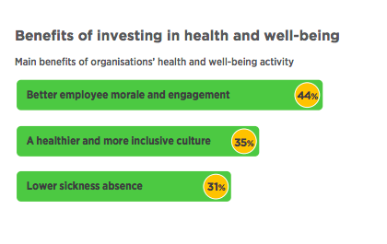
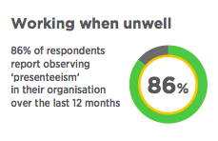
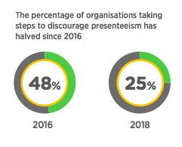
https://www.cipd.co.uk/Images/health-and-well-being-at-work-infographic-1_tcm18-40892.pdf

Slide 25
What can employees do to remain healthy at work?

Slide 26
Who is in the British workplace?
32.4million people at work in the UK
That is a 75.5% employment rate
1.36 million people who are seeking work
8.76 million economically inactive
(ONS, 2018)
https://www.ons.gov.uk/employmentandlabourmarket/peopleinwork/employmentandemployeetypes/bulletins/uklabourmarket/september2018
Also see https://data.oecd.org/emp/employment-rate-by-age-group.htm

Slide 27
What jobs do they do?
https://www.ons.gov.uk/employmentandlabourmarket/peopleinwork/employmentandemployeetypes/datasets/employmentbyindustryemp13

Slide 28
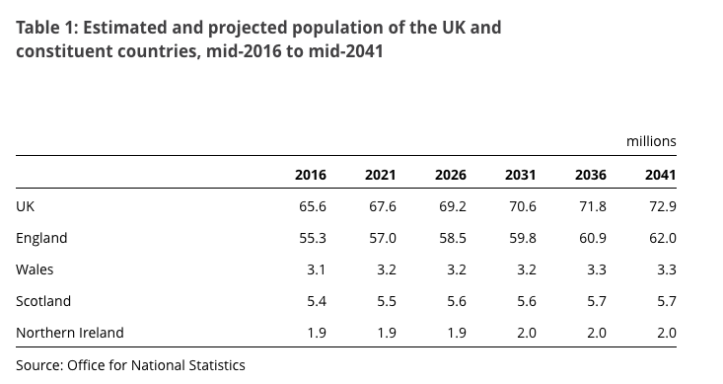
Population (Census data 2011)
The median age for the population of England and Wales was 39 years
21% of the overall population of England and Wales was aged under 18 years,
29% was aged 18 to 39 years,
27% was aged 40 to 59 years
22% was aged 60+ years
https://www.ethnicity-facts-figures.service.gov.uk/british-population/demographics/age-groups/latest
https://www.ons.gov.uk/peoplepopulationandcommunity/populationandmigration/populationprojections/bulletins/nationalpopulationprojections/2016basedstatisticalbulletin

Slide 29

Changing Future Context
The global economy
Pensions/working longer/living longer
Productivity
Brexit
Gig economy
Flexible working/24hour/shift work/work-life balance
Increase in self-employed
Automation and job insecurity
The future of work
Notes:
Comorbidity

Slide 30
The future is uncertain what should we do?
RSA Inclusive growth film
Culture shift
Secure, the health wellbeing and skills of today’s young people.
Adopt a lifecourse approach
Extra help for SME’s
Extra help for Gig Economy workers
Ill health prevention
Settings approach
Investment is required

Slide 31
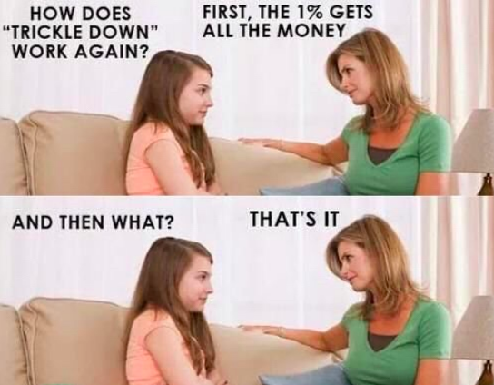
Alternatively
WAIT FOR NEOLIBRAL ECONOMICS/CAPITALISM TO SOLVE THE PROBLEM

Slide 32
Key reports
Is work good for you? (2006)
The Black Report - Working for a healthier tomorrow: work and health in Britain (2008)
Boorman Review (2009)
Health and Work: An independent review (2011)
SDGs Goal 8 (2015)
Stephenson Farmer Review (2017)
Improving lives: The future of work, health and disability (2017)
Taylor Review and Government Response (2018)

Slide 33
Work across the life-course
Starting work – personal challenge and risk
Middle age – balancing work and home physical and mental demands
Older workers – physical demands health and caring responsibilities
Beyond retirement – unpaid work
All vulnerable from physical hazards, and prolonged exposure is more likely to lead to ill health

Slide 34
Factors that influence ability to work beyond retirement
The decision to work or ‘retire’:
Personal circumstances – family, caring responsibility, married, divorced
Financial
Leisure time pursuits
Physical and mental health – comorbidity, 2 or more chronic health conditions multiplemorbidity
Motivation/willingness to continue
Education (fewer older people have degrees) and can’t progress
The workplace policies, culture and practice e.g. flexible work, training

Slide 35
Sustainable work
“sustainable work over the life course means that working and living conditions are such that they support people in engaging and remaining in work over the course of an extended working life. These conditions enable a better fit between work and the characteristics or circumstances of the individual over the lifecourse”
(Eurofound, 2017, p8)

Slide 36
What does a healthy workplace look like to you?

Slide 37
Definition of a Healthy Workplace
A healthy workplace is one in which workers and managers collaborate to use a continual improvement process to protect and promote the health, safety and well-being of all workers and the sustainability of the workplace by considering the following, based on identified needs:
health and safety concerns in the physical work environment;
health, safety and well-being concerns in the psychosocial work environment, including organization of work and workplace culture;
personal health resources in the workplace; and
ways of participating in the community to improve the health of workers, their families and other members of the community. (Neira, 2010, p6)

Slide 38
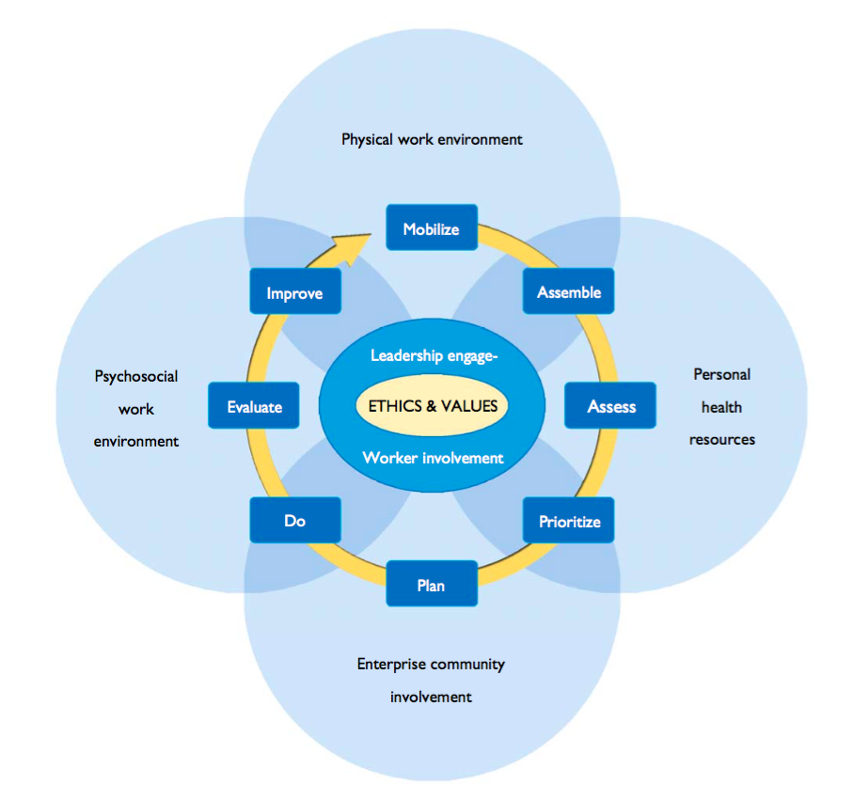
WHO Healthy Workplace Model (Neira, 2010, p.8)

Slide 39
Why is it important to have a healthy workplace?

Slide 40
Directed Study – Watch this Film
Britain’s Hardest Workers; Inside the low wage economy
https://learningonscreen.ac.uk/ondemand/index.php/prog/0D61D34A
When watching this video think about:
The type of work being done
Where the work is done
The people that usually do these jobs
The impact of the economy and capitalism on the types low paid jobs available
Listen to the stories of the people that have volunteered to do the work in this TV experiment
See if you can spot any hazards to physical and mental health
Consider what impact an ill health event or medical condition might have on the workers ability to do this work.
Be prepared to discuss next week

Slide 41
References
Davies, A.R., Homolova, L., Grey, C. and Bellis, M.A. (2017) Mass Unemployment Events (MUEs) – Prevention and Response from a Public Health Perspective. Cardiff: Public Health Wales (copy on Bb)
Neira, M. (2010) Healthy workplaces a model for action, for employers, workers, policy makers and practitioners. Geneva: WHO (copy on Bb)
Eurofound (2017), Working conditions of workers of different ages: European Working Conditions Survey 2015 Publications Office of the European Union, Luxembourg. (copy on Bb)
Lui, J.L.Y., Maniadakis, N., Gray, A. and Rayner, M. (2002) ‘The economic burden of heart disease’, Heart, 88(6): 597–603.
Scarborough, P., Bhatnagar, P., Wickramasinghe, K.K., Allender, S., Foster,C. and Rayner, M. (2011) ‘The economic burden of ill health due to diet, physical inactivity, smoking, alcohol and obesity in the UK: an update to 2006–07 NHS costs’, Journal of Public Health, 33(4), pp. 527-535, https://doi.org/10.1093/pubmed/fdr033

